Slide 1
Weighted bootstrapping making more use of more recent data
OCTOBER 2024

Slide 2
INPUTS INTO SCENARIO GENERATION
We’ve now covered Monte Carlo simulation and simple boot-strapping.
We randomly selected several short periods from history and combined them to generate scenarios of our desired length.
The short periods we choose are just as likely to come from the recent past as from long ago. Is that a good thing?
There’s a never-ending trade-off between going back in time to get as much data as you can, and the fact that the world may have changed since then.

Slide 3
Dealing with change
Consider the monthly returns of this asset.
It looks as if something might have fundamentally changed about seven months ago.
If so, do we really want to use data older than this? Should we throw it away?
Time-weighting is a way of still using all the data, but attaching greater importance to more recent data.

Slide 4
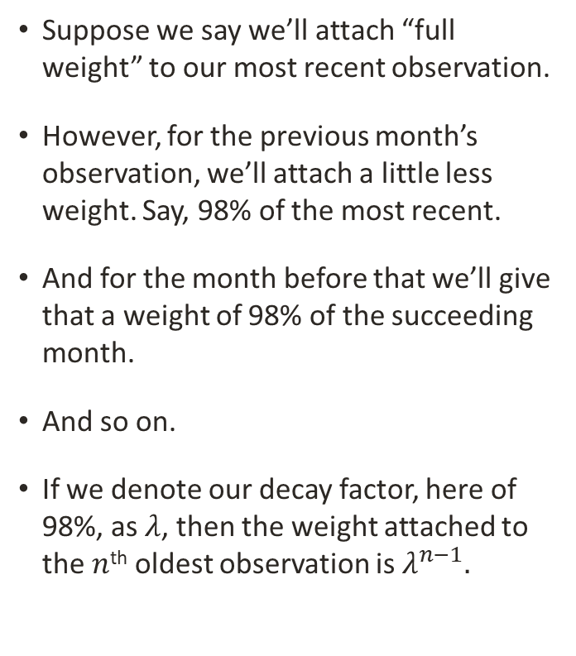
Exponential weighting
Suppose we say we’ll attach “full weight” to our most recent observation.
However, for the previous month’s observation, we’ll attach a little less weight. Say, 98% of the most recent.
And for the month before that we’ll give that a weight of 98% of the succeeding month.
And so on.
If we denote our decay factor, here of 98%, as $λ$, then the weight attached to the $n$^{th} oldest observation is $λ^{n−1}.$

Slide 5
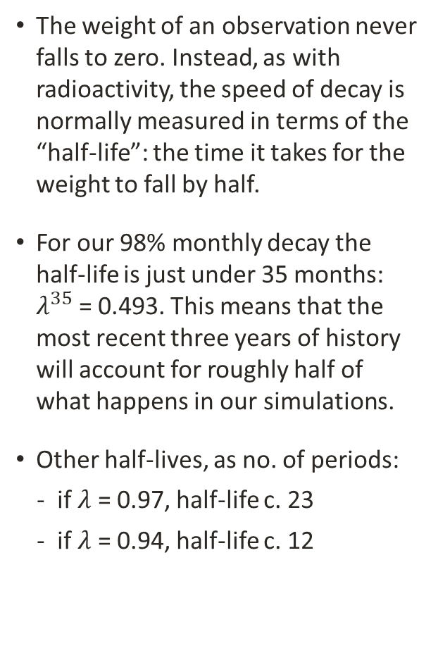
Half-lives
The weight of an observation never falls to zero. Instead, as with radioactivity, the speed of decay is normally measured in terms of the “half-life”: the time it takes for the weight to fall by half.
For our 98% monthly decay the half-life is just under 35 months: $λ^{35}$ = 0.493. This means that the most recent three years of history will account for roughly half of what happens in our simulations.
Other half-lives, as no. of periods:
if $λ$ = 0.97, half-life c. 23
if $λ$ = 0.94, half-life c. 12

Slide 6
Variations on exponential weighting
Other weighting schemes are available, and it could be useful to mix schemes.
For example, it could be that a historical period of heightened volatility could be of concern, and given a full weight.
Another period that is unlikely to recur could be given a zero weight to exclude it from our scenarios.

